Slide 1
In-class Exercise 08 - Sobel Edge Detection
Dhiren Gupta
-800902466

Slide 2
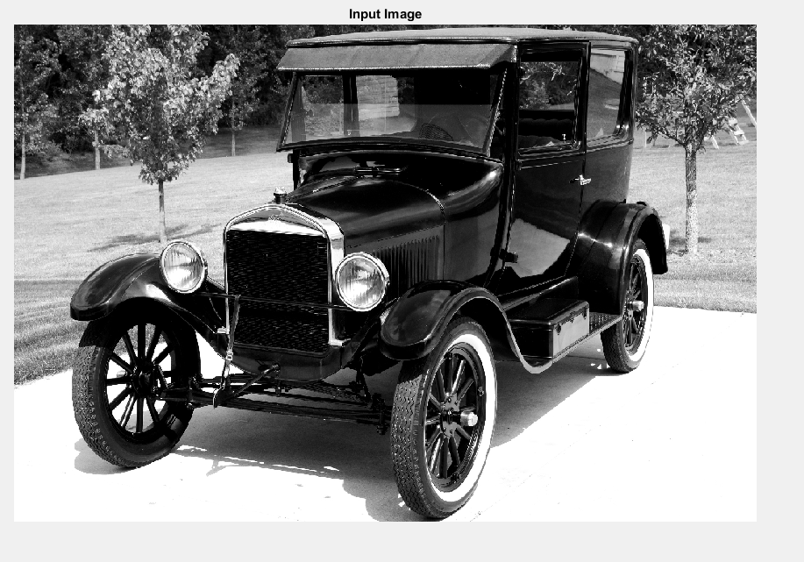
Input Image

Slide 3
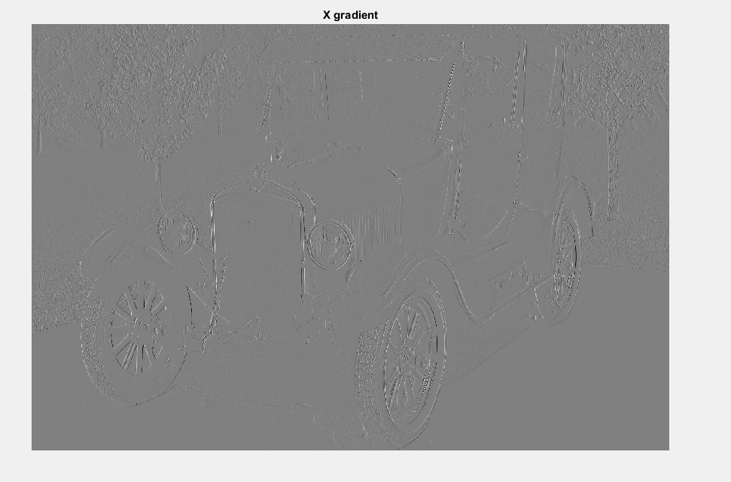
Gradient x

Slide 4
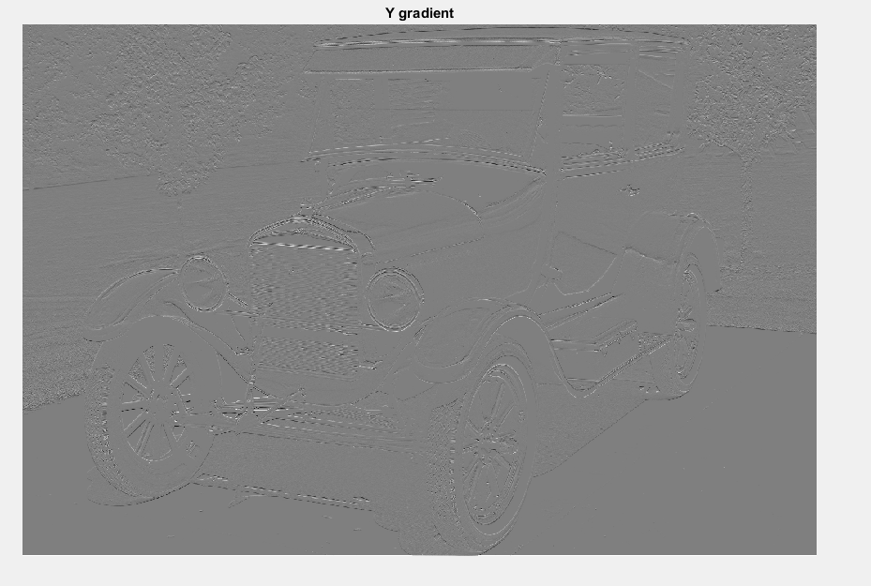
Gradient y

Slide 5
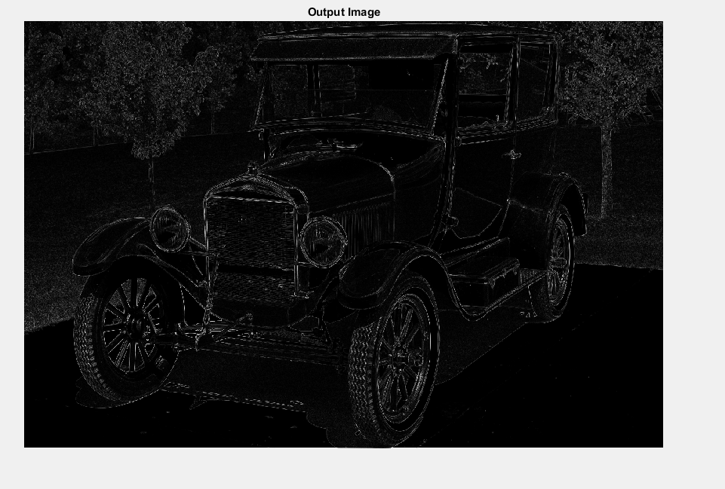
Output Image

Slide 6
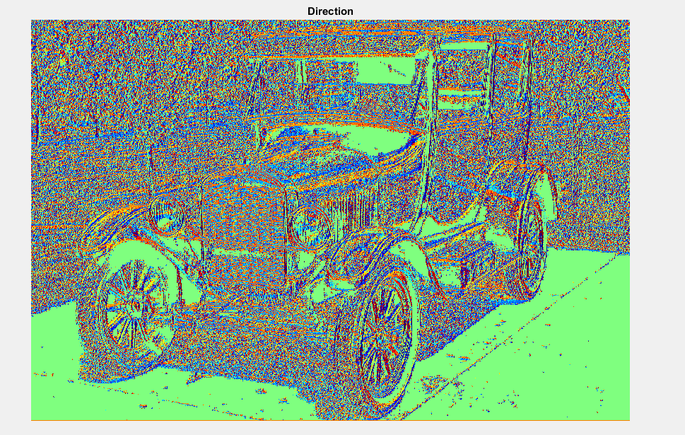
Gradient Direction

Slide 7
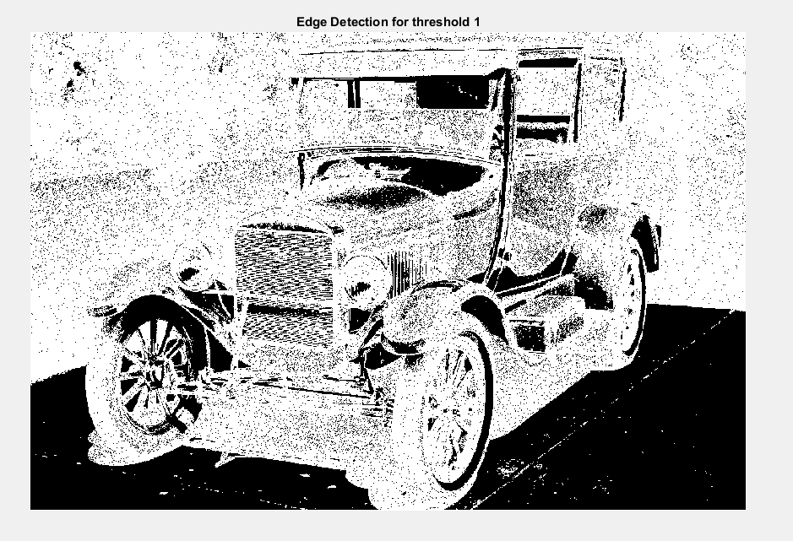
Threshold =1

Slide 8
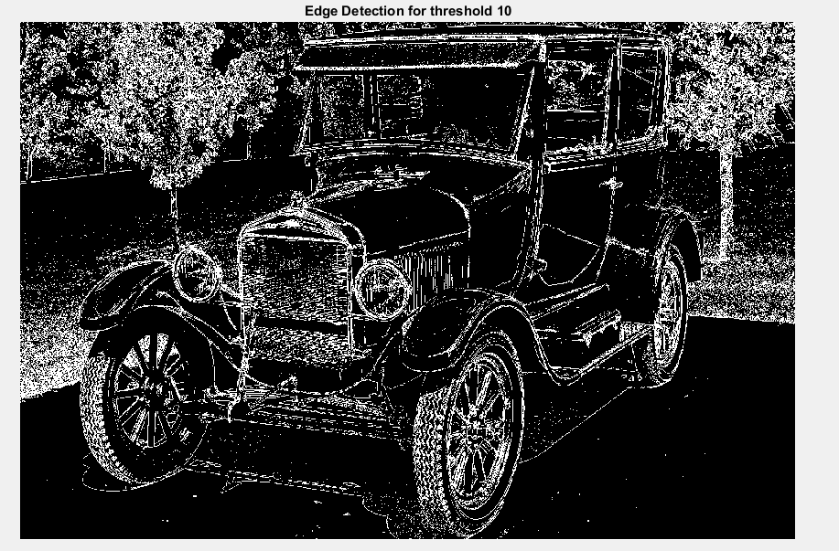
Threshold=10

Slide 9
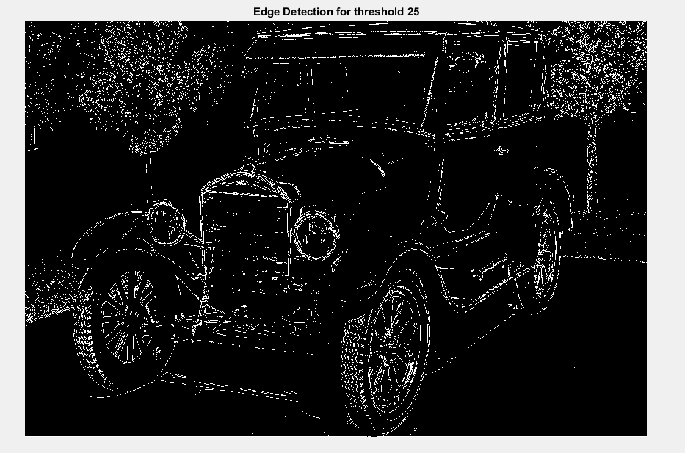
Threshold=25

Slide 10
Thank You

